Slide 1
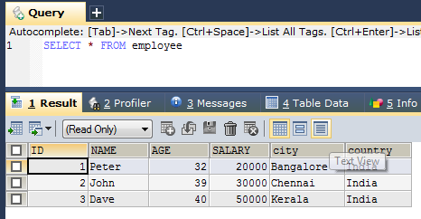
SQL SELECT
If we want to select all the fields available in the table, use the following syntax:
The SELECT statement is used to select data from a database.
The data returned is stored in a result table, called the result-set.
SELECT * FROM table_name;

Slide 2
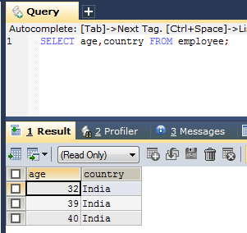
SQL SELECT
Here, column1, column2, ... are the field names of the table you want to select data from
The following SQL statement selects the “age" and “country" columns from the “employee" table
SELECT column1, column2, ... FROM table_name;

